Slide 1

Chapter 5: Problem Solving with Repetition

Slide 2
Outline
Learning Outcomes
Loop structure
While, do-while and for loops
Nested loops
Input/output from file
At the end of this chapter, student should be able to:
Use problem-solving chart to develop a solution using loop structure. (C3, CTPS)
Construct program using while and do-while loop. (C3)
Use automatic counter and nested loop to develop problem solution (C3, CTPS)
Construct program using automatic counter and nested loop. (C3)
Distinguish the different uses of three types of loop structure. (C4)
Use file to read/write input/ouput. (C3)

Slide 3
Control Statements
A basic mechanisms in a programming language that control the order in which program statements are executed.
Three basic control statements used in programming:
1. Sequence statements
Performs a series of steps in a definitely sequence.
2. Selection/decision Statements
Make decision based on certain conditions
3. Repetition/loop Statements
Repeat a sequence structure under certain conditions

Slide 4

Motivation
How to input name for 50 students?
How to calculate total marks for 50 students?
How to calculate total marks for more than one students?
...
And in many more problems that need us to process more than once
how do we solve these problems?

Slide 5
Repetition (Loop) Logic Structure
Repeat structure
To solve the problem that doing the same task over and over for different sets of data
Types of loop:
WHILE loop
Do..WHILE loop
Automatic-Counter Loop
The challenge is identifying what instructions should be repeated

Slide 6

While loop

Slide 7
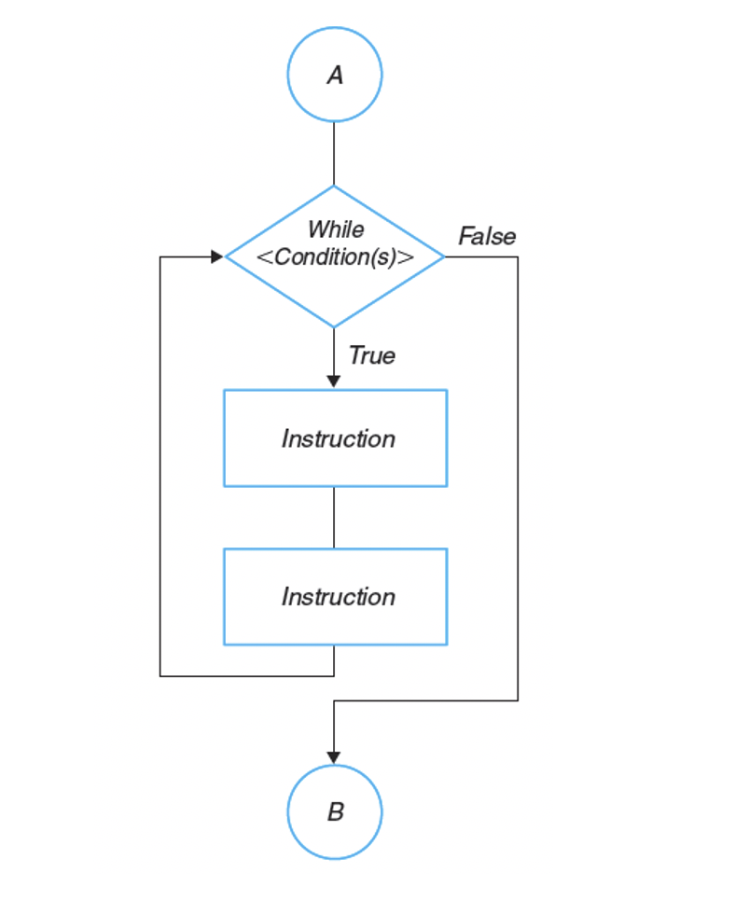
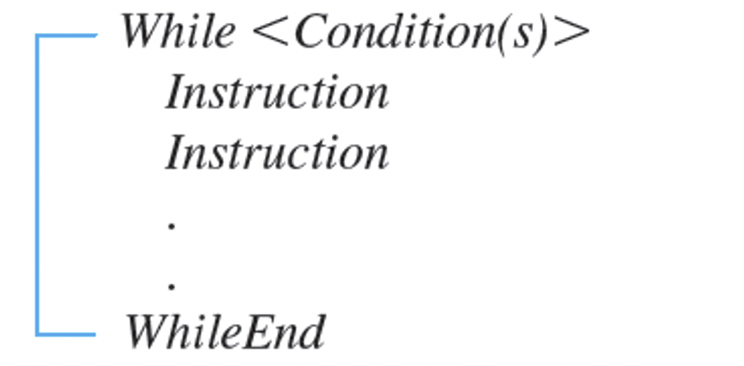
While/WhileEnd

Slide 8
Exercise
Write a code segment to display “Welcome to UPM” 2 times?
Write a code segment to display “Welcome to UPM” 200 times?

Slide 9
while Loop
How to display a string Welcome to UPM 2 times?
Do the loop body if the condition is true.
Algorithm (Pseudocode):
Set the count = 0
While (count < 2)
Print “Welcome to UPM”
count = count + 1
WhileEnd
Start
count = 0
False
count <2
True
Print “Welcome to UPM”
count = count + 1
End

Slide 10
while Loop
1. int count=0;
2. while (count < 2){
3. System.out.println("Welcome to UPM");
4. count = count+1;
5. }
Statement number | count | count<2 | output
1 | 0
2 |  | true
3 |  |  | Welcome to UPM
4 | 1
2 |  | true
3 |  |  | Welcome to UPM
4 | 2
2 |  | false

Slide 11
while Loop
Do the loop body if the condition is true.
Example 1:
To print the numbers from 1 to 100.
Algorithm (pseudocode):
Set the number = 1
While (number <= 100) repeat:
Print number
number = number + 1
End While
Start
number = 1
N
number <= 100
Y
Print number
number = number + 1
End

Slide 12
while Loop
Start
Example 2:
Get the sum of 1, 2, 3, …, 5.
Algorithm:
Set the number = 1
Set the total = 0
While (number <= 5)
total = total + number
number = number + 1
WhileEnd
Display total
Set number = 1
Set total = 0
number <= 5
False
True
Display total
total =
total + number
number | total
1 | 0
End
number =
number + 1

Slide 13
while Loop
Start
Example 2:
Get the sum of 1, 2, 3, …, 5.
Algorithm:
Set the number = 1
Set the total = 0
While (number <= 5)
total = total + number
number = number + 1
WhileEnd
Display total
Set number = 1
Set total = 0
number <= 5
False
True
Display total
total =
total + number
number | total
1 | 0
End
number =
number + 1

Slide 14
while Loop
Start
Example 2:
Get the sum of 1, 2, 3, …, 5.
Algorithm:
Set the number = 1
Set the total = 0
While (number <= 5)
total = total + number
number = number + 1
WhileEnd
Display total
Set number = 1
Set total = 0
number <= 5
False
True
Display total
total =
total + number
number | total
1 | 0
 | 1
End
number =
number + 1

Slide 15
while Loop
Start
Example 2:
Get the sum of 1, 2, 3, …, 5.
Algorithm:
Set the number = 1
Set the total = 0
While (number <= 5)
total = total + number
number = number + 1
WhileEnd
Display total
Set number = 1
Set total = 0
number <= 5
False
True
Display total
total =
total + number
number | total
1 | 0
2 | 1
End
number =
number + 1

Slide 16
while Loop
Start
Example 2:
Get the sum of 1, 2, 3, …, 5.
Algorithm:
Set the number = 1
Set the total = 0
While (number <= 5)
total = total + number
number = number + 1
WhileEnd
Display total
Set number = 1
Set total = 0
number <= 5
False
True
Display total
total =
total + number
number | total
1 | 0
2 | 1
 | 3
End
number =
number + 1

Slide 17
while Loop
Start
Example 2:
Get the sum of 1, 2, 3, …, 5.
Algorithm:
Set the number = 1
Set the total = 0
While (number <= 5)
total = total + number
number = number + 1
WhileEnd
Display total
Set number = 1
Set total = 0
number <= 5
False
True
Display total
total =
total + number
number | total
1 | 0
2 | 1
3 | 3
End
number =
number + 1

Slide 18
while Loop
Start
Example 2:
Get the sum of 1, 2, 3, …, 5.
Algorithm:
Set the number = 1
Set the total = 0
While (number <= 5)
total = total + number
number = number + 1
WhileEnd
Display total
Set number = 1
Set total = 0
number <= 5
False
True
Display total
total =
total + number
number | total
1 | 0
2 | 1
3 | 3
 | 6
End
number =
number + 1

Slide 19
while Loop
Start
Example 2:
Get the sum of 1, 2, 3, …, 5.
Algorithm:
Set the number = 1
Set the total = 0
While (number <= 5)
total = total + number
number = number + 1
WhileEnd
Display total
Set number = 1
Set total = 0
number <= 5
False
True
Display total
total =
total + number
number | total
1 | 0
2 | 1
3 | 3
4 | 6
End
number =
number + 1

Slide 20
while Loop
Start
Example 2:
Get the sum of 1, 2, 3, …, 5.
Algorithm:
Set the number = 1
Set the total = 0
While (number <= 5)
total = total + number
number = number + 1
WhileEnd
Display total
Set number = 1
Set total = 0
number <= 5
False
True
Display total
total =
total + number
number | total
1 | 0
2 | 1
3 | 3
4 | 6
 | 10
End
number =
number + 1

Slide 21
while Loop
Start
Example 2:
Get the sum of 1, 2, 3, …, 5.
Algorithm:
Set the number = 1
Set the total = 0
While (number <= 5)
total = total + number
number = number + 1
WhileEnd
Display total
Set number = 1
Set total = 0
number <= 5
False
True
Display total
total =
total + number
number | total
1 | 0
2 | 1
3 | 3
4 | 6
5 | 10
End
number =
number + 1

Slide 22
while Loop
Start
Example 2:
Get the sum of 1, 2, 3, …, 5.
Algorithm:
Set the number = 1
Set the total = 0
While (number <= 5)
total = total + number
number = number + 1
WhileEnd
Display total
Set number = 1
Set total = 0
number <= 5
False
True
Display total
total =
total + number
number | total
1 | 0
2 | 1
3 | 3
4 | 6
5 | 10
 | 15
End
number =
number + 1

Slide 23
while Loop
Start
Example 2:
Get the sum of 1, 2, 3, …, 5.
Algorithm:
Set the number = 1
Set the total = 0
While (number <= 5)
total = total + number
number = number + 1
WhileEnd
Display total
Set number = 1
Set total = 0
number <= 5
False
True
Display total
total =
total + number
number | total
1 | 0
2 | 1
3 | 3
4 | 6
5 | 10
6 | 15
End
number =
number + 1

Slide 24
while Loop
Start
Example 2:
Get the sum of 1, 2, 3, …, 5.
Algorithm:
Set the number = 1
Set the total = 0
While (number <= 5)
total = total + number
number = number + 1
WhileEnd
Display total
Set number = 1
Set total = 0
number <= 5
False
True
Display total
total =
total + number
number | total
1 | 0
2 | 1
3 | 3
4 | 6
5 | 10
6 | 15
End
number =
number + 1
Output:
15

Slide 25
while Loop Flow Chart
int count = 0;
while (count < 10) {
System.out.println("Welcome to Java!");
count++;
}
while (loop-continuation-condition) {
// loop-body;
Statement(s);
}
count = 0;
(count < 10)?
false
Loop
Continuation
Condition?
false
true
true
System.out.println
("Welcome to Java!");
Statement(s)
(loop body)
count++;
(A)
(B)

Slide 26
Trace while Loop
animation
Initialize count
int count = 0;
while (count < 2) {
System.out.println("Welcome to Java!");
count++;
}
count
0

Slide 27
Trace while Loop, cont.
animation
(count < 2) is true
int count = 0;
while (count < 2) {
System.out.println("Welcome to Java!");
count++;
}
count
0

Slide 28
Trace while Loop, cont.
animation
Print Welcome to Java!
int count = 0;
while (count < 2) {
System.out.println("Welcome to Java!");
count++;
}
count
0
Output/Console:
Welcome to Java!

Slide 29
Trace while Loop, cont.
animation
Increase count by 1
count is 1 now
int count = 0;
while (count < 2) {
System.out.println("Welcome to Java!");
count++;
}
count
1
Output/Console:
Welcome to Java!

Slide 30
Trace while Loop, cont.
animation
(count < 2) is still true since count is 1
int count = 0;
while (count < 2) {
System.out.println("Welcome to Java!");
count++;
}
count
1
Output/Console:
Welcome to Java!

Slide 31
Trace while Loop, cont.
animation
Print Welcome to Java
int count = 0;
while (count < 2) {
System.out.println("Welcome to Java!");
count++;
}
count
1
Output/Console:
Welcome to Java!
Welcome to Java!

Slide 32
Trace while Loop, cont.
animation
Increase count by 1
count is 2 now
int count = 0;
while (count < 2) {
System.out.println("Welcome to Java!");
count++;
}
count
2
Output/Console:
Welcome to Java!
Welcome to Java!

Slide 33
Trace while Loop, cont.
animation
(count < 2) is false since count is 2 now
int count = 0;
while (count < 2) {
System.out.println("Welcome to Java!");
count++;
}
count
2
Output/Console:
Welcome to Java!
Welcome to Java!

Slide 34
Trace while Loop
animation
The loop exits. Execute the next statement after the loop.
int count = 0;
while (count < 2) {
System.out.println("Welcome to Java!");
count++;
}
count
2
Output/Console:
Welcome to Java!
Welcome to Java!

Slide 35
Examples
int b = 10;
while (b > 6) {
System.out.print(b + " ");
b--;
}
System.out.print("End loop");
Loop body is executed, until the condition becomes False
int b = 10;
while (b < 6) {
System.out.print(b + " ");
b--;
}
System.out.print("End loop");
Loop body is never executed, because the condition is always False

Slide 36
Examples: Indefinite loop
Loop body is executed, and never stop, because the condition is always True
int b = 10;
while (b > 6) {
System.out.print(b + “ “);
}
System.out.print(“End loop”);
Loop variable is not updated
int b = 10;
while (b > 6) {
System.out.print(b + “ “);
b++;
}
System.out.print(“End loop”);
Loop variable is incorrectly updated

Slide 37
Loop Control
Each loop must have:
Initial value
Control expression / end value
Next value
int b = 10;
while (b > 6) {
System.out.print(b + “ “);
b--;
}
System.out.print(“End loop”);

Slide 38
Example 3: Average Mark
Write a program to find an average first test marks of your group.

Slide 39
Example 3: Average Mark
PAC
GivenData | Required Results
5 marks | averageMark
Processing Required | Solution Alternatives
Use while loop to input 5 marks and calculate totalMark Calculate totalMark Calculate averageMark | Define the mark as input values.
IPO
Input | Processing | Module | Output
5 marks | Repeat 5 times: Read mark Calculate totalMark = totalMark+mark End repeat Calculate averageMark = totalMark/5 Display averageMark |  | averageMark

Slide 40
Example 3: Average Mark
Pseudocode:
Start
Set totalMark= 0.0
Set count = 0
while (count < 5):
Read mark totalMark = totalMark + mark count = count + 1
averageMark = totalMark/5
Print averageMark
End
Flowchart?

Slide 41
Example 3: Average Mark
Java Program
Scanner input = new Scanner(System.in);
System.out.print(“Enter five marks: “);
int count = 0;
double total = 0.0;
double mark = 0.0;
while (count < 5) {
mark = input.nextDouble(); //Read mark
total += mark; //Add mark to total
count++; //Increase for next iteration
}
double average = total/5;
System.out.print(“Average mark is ” + average);

Slide 42
Exercise: Average Mark
To calculate and print the average of five marks:
Start
Set totalMark= 0.0
Set count = 0
while (count < 5)
3.1 Read mark
3.2 count = count +1
4. Endwhile
5. totalMark = totalMark + mark
6. averageMark = totalMark/5
7. Print averageMark
End
What is wrong with this algorithm?

Slide 43
Exercises
Write a while loop that prints the numbers from 1 to 100.
Write a while loop to get the sum of 1 to 100 integer numbers ( 1+2+3+..+100)

Slide 44
Program that reads and calculates the sum of an unspecified number of integers. The input 0 signifies the end of the input.
import java.util.Scanner;
public class SumIntegers {
public static void main(String[] args) {
Scanner input = new Scanner(System.in);
System.out.print("Enter an integer value: ");
int data = input.nextInt();
int sum = 0;
while (data != 0) {
sum = sum + data;
System.out.print("Enter an integer value: ");
data = input.nextInt();
}
System.out.print("The sum is " + sum);
}
}

Slide 45
Examples using while Loops
Draw a flowchart that reads 100 random integer numbers and display each of them.
Write a pseudocode that finds the smallest of 100 integer numbers.
Write a program that reads and calculates the sum of an unspecified number of integers. The input 0 signifies the end of the input.

Slide 46
Do..while loop

Slide 47
do..while Loop
do {
// Loop body;
Statement(s);
} while (loop-continuation-condition);

Slide 48
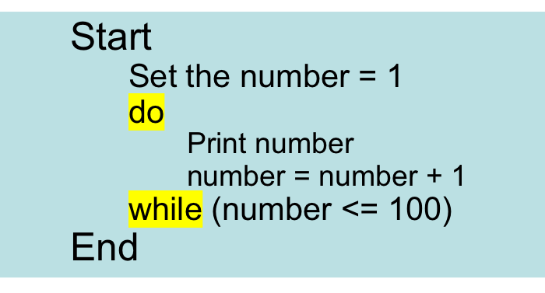
do..while Loop
Example 1:
To print the numbers from 1 to 100.
(from while loop…)
Algorithm (Pseudocode):
Start
Set the number = 1
While (number <= 100)
Print number
number = number + 1
WhileEnd
End

Slide 49
do..while Loop
The body of the loop will execute first before checking the condition.
Example:
Get the sum of 1, 2, 3, …100.

Slide 50
do..while Loop
Start
Set number = 1
Set total = 0
total =
total + number
False
number =
number + 1
Display total
while
number <= 100
End
True

Slide 51
public class Sum1_100 {
public static void main(String[] args) {
int number = 1;
int sum = 0;
do {
sum = sum + number;
number++;
} while (number <= 5);
System.out.println(“The sum is “ + sum);
}
}
number | sum
1 | 0

Slide 52
public class Sum1_100 {
public static void main(String[] args) {
int number = 1;
int sum = 0;
do {
sum = sum + number;
number++;
} while (number <= 5);
System.out.println(“The sum is “ + sum);
}
}
number | sum
1 | 0
 | 1

Slide 53
public class Sum1_100 {
public static void main(String[] args) {
int number = 1;
int sum = 0;
do {
sum = sum + number;
number++;
} while (number <= 5);
System.out.println(“The sum is “ + sum);
}
}
number | sum
1 | 0
2 | 1

Slide 54
public class Sum1_100 {
public static void main(String[] args) {
int number = 1;
int sum = 0;
do {
sum = sum + number;
number++;
} while (number <= 5);
System.out.println(“The sum is “ + sum);
}
}
number | sum
1 | 0
2 | 1
 | 3

Slide 55
public class Sum1_100 {
public static void main(String[] args) {
int number = 1;
int sum = 0;
do {
sum = sum + number;
number++;
} while (number <= 5);
System.out.println(“The sum is “ + sum);
}
}
number | sum
1 | 0
2 | 1
3 | 3

Slide 56
public class Sum1_100 {
public static void main(String[] args) {
int number = 1;
int sum = 0;
do {
sum = sum + number;
number++;
} while (number <= 5);
System.out.println(“The sum is “ + sum);
}
}
number | sum
1 | 0
2 | 1
3 | 3
 | 6

Slide 57
public class Sum1_100 {
public static void main(String[] args) {
int number = 1;
int sum = 0;
do {
sum = sum + number;
number++;
} while (number <= 5);
System.out.println(“The sum is “ + sum);
}
}
number | sum
1 | 0
2 | 1
3 | 3
4 | 6

Slide 58
public class Sum1_100 {
public static void main(String[] args) {
int number = 1;
int sum = 0;
do {
sum = sum + number;
number++;
} while (number <= 5);
System.out.println(“The sum is “ + sum);
}
}
number | sum
1 | 0
2 | 1
3 | 3
4 | 6
 | 10

Slide 59
public class Sum1_100 {
public static void main(String[] args) {
int number = 1;
int sum = 0;
do {
sum = sum + number;
number++;
} while (number <= 5);
System.out.println(“The sum is “ + sum);
}
}
number | sum
1 | 0
2 | 1
3 | 3
4 | 6
5 | 10

Slide 60
public class Sum1_100 {
public static void main(String[] args) {
int number = 1;
int sum = 0;
do {
sum = sum + number;
number++;
} while (number <= 5);
System.out.println(“The sum is “ + sum);
}
}
number | sum
1 | 0
2 | 1
3 | 3
4 | 6
5 | 10
 | 15

Slide 61
public class Sum1_100 {
public static void main(String[] args) {
int number = 1;
int sum = 0;
do {
sum = sum + number;
number++;
} while (number <= 5);
System.out.println(“The sum is “ + sum);
}
}
number | sum
1 | 0
2 | 1
3 | 3
4 | 6
5 | 10
6 | 15

Slide 62
public class Sum1_100 {
public static void main(String[] args) {
int number = 1;
int sum = 0;
do {
sum = sum + number;
number++;
} while (number <= 5);
System.out.println(“The sum is “ + sum);
}
}
number | sum
1 | 0
2 | 1
3 | 3
4 | 6
5 | 10
6 | 15
OUTPUT:
The sum is 15

Slide 63
Example 3: Average Mark
Pseudocode:
Start
Set totalMark= 0.0
Set count = 0
do:
Read mark totalMark = totalMark + mark count = count + 1
while (count < 5)
averageMark = totalMark/5
Print averageMark
End
Flowchart?

Slide 64
Example using do-while Loop
Draw a flowchart that reads 100 random integer numbers.
Write a pseudocode that finds the smallest of 100 integer numbers.
Write a program that reads and calculates the sum of an unspecified number of integers. The input 0 signifies the end of the input.

Slide 65
import javax.util.Scanner;
public class SumIntegers {
public static void main(String[] args) {
int data;
int sum = 0;
Scanner input = new Scanner(System.in);
do {
System.out.print (“Enter an integer value:\n(the program exits if the input is 0)”);
data = input.nextInt();
sum = sum + data;
} while (data != 0);
System.out.println (“The sum is “ + sum);
}
}

Slide 66
Trace do-while Loop
animation
Initialize count
int count = 0;
do {
System.out.println("Welcome to Java!");
count++;
} while (count < 2);
count
0

Slide 67
Trace do-while Loop
animation
Print Welcome to Java!
int count = 0;
do {
System.out.println("Welcome to Java!");
count++;
} while (count < 2);
count
0
Output/Console:
Welcome to Java!

Slide 68
Trace do-while Loop
animation
Increase count by 1
count is 1 now
int count = 0;
do {
System.out.println("Welcome to Java!");
count++;
} while (count < 2);
count
1
Output/Console:
Welcome to Java!

Slide 69
Trace do-while Loop
animation
(count < 2) is still true since count is 1
int count = 0;
do {
System.out.println("Welcome to Java!");
count++;
} while (count < 2);
count
1
Output/Console:
Welcome to Java!

Slide 70
Trace do-while Loop
animation
Print Welcome to Java
int count = 0;
do {
System.out.println("Welcome to Java!");
count++;
} while (count < 2);
count
1
Output/Console:
Welcome to Java!
Welcome to Java!

Slide 71
Trace do-while Loop
animation
Increase count by 1
count is 2 now
int count = 0;
do {
System.out.println("Welcome to Java!");
count++;
} while (count < 2);
count
2
Output/Console:
Welcome to Java!
Welcome to Java!

Slide 72
Trace do-while Loop
animation
(count < 2) is false since count is 2 now
int count = 0;
do {
System.out.println("Welcome to Java!");
count++;
} while (count < 2);
count
2
Output/Console:
Welcome to Java!
Welcome to Java!

Slide 73
Trace do-while Loop
animation
The loop exits. Execute the next statement after the loop.
int count = 0;
do {
System.out.println("Welcome to Java!");
count++;
} while (count < 2);
count
2
Output/Console:
Welcome to Java!
Welcome to Java!

Slide 74
Example
int b = 10;
do {
System.out.print(b + “ “);
b--;
} while (b > 6);
System.out.print(“End loop”);
Loop body is executed, until the condition becomes False
Output:
Compare with previous example using while:
int b = 10;
while (b > 6) {
System.out.print(b + “ “);
b--;
}
System.out.print(“End loop”);
Output:
10 9 8 7 End loop

Slide 75
Examples
int b = 10;
while (b < 6) {
System.out.print(b + “ “);
b--;
}
System.out.print(“End loop”);
Remember this example?
Using the while loop.
Loop body is never executed, because the condition is always False
int b = 10;
do {
System.out.print(b + “ “);
b--;
} while (b < 6);
System.out.print(“End loop”);
In a do-while loop,
loop body is executed once, before the condition becomes False

Slide 76
Exercises
Write a do…while loop that prints the numbers from 1 to 100.
Write a do…while loop to get the sum of 1 to 100 integer numbers ( 1+2+3+..+100)

Slide 77
For loop

Slide 78
Automatic Counter Loop
Use variable as a counter that starts counting at a specified number and update the variable each time the loop is processed.
The beginning value, the ending value and the updating value may be constant.
They should not be changed during the processing of the instruction in the loop.

Slide 79
Automatic-Counter Loop
A
C
Begin End
Step
FALSE
TRUE
INSTRUCTION
INSTRUCTION
C
B

Slide 80
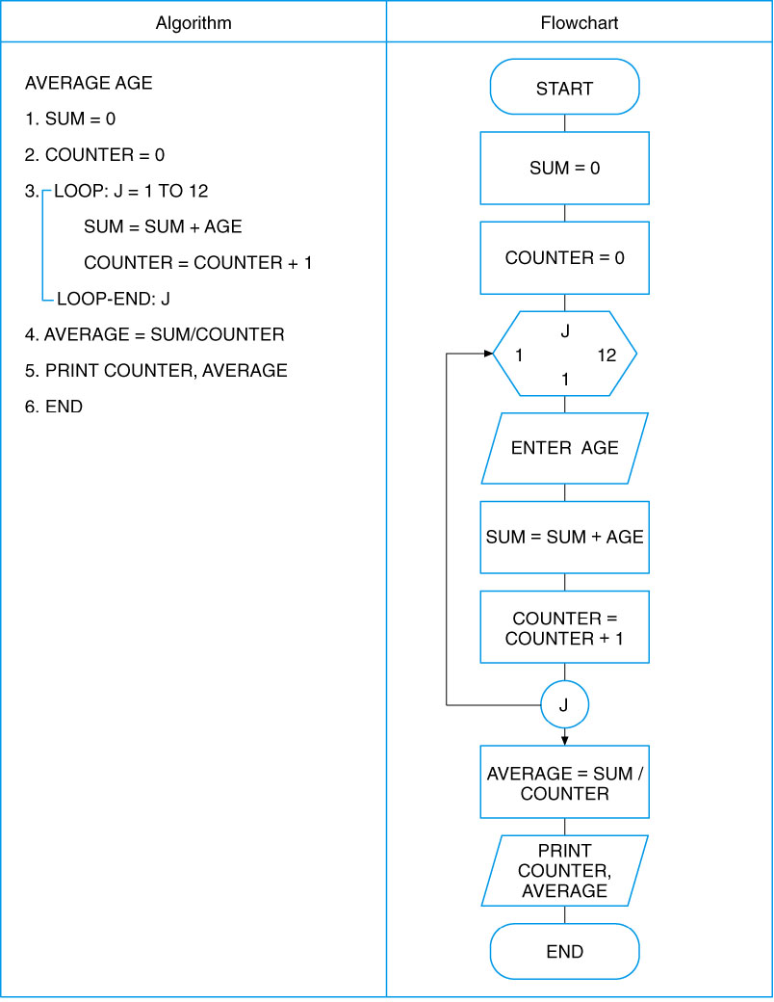
Automatic-Counter Loop

Slide 81
for Loops
for (initial-action; loop-continuation-condition; action-after-each-iteration) {
// loop body;
Statement(s);
}
int i;
for (i = 0; i < 100; i++) {
System.out.println
("Welcome to Java!");
}

Slide 82
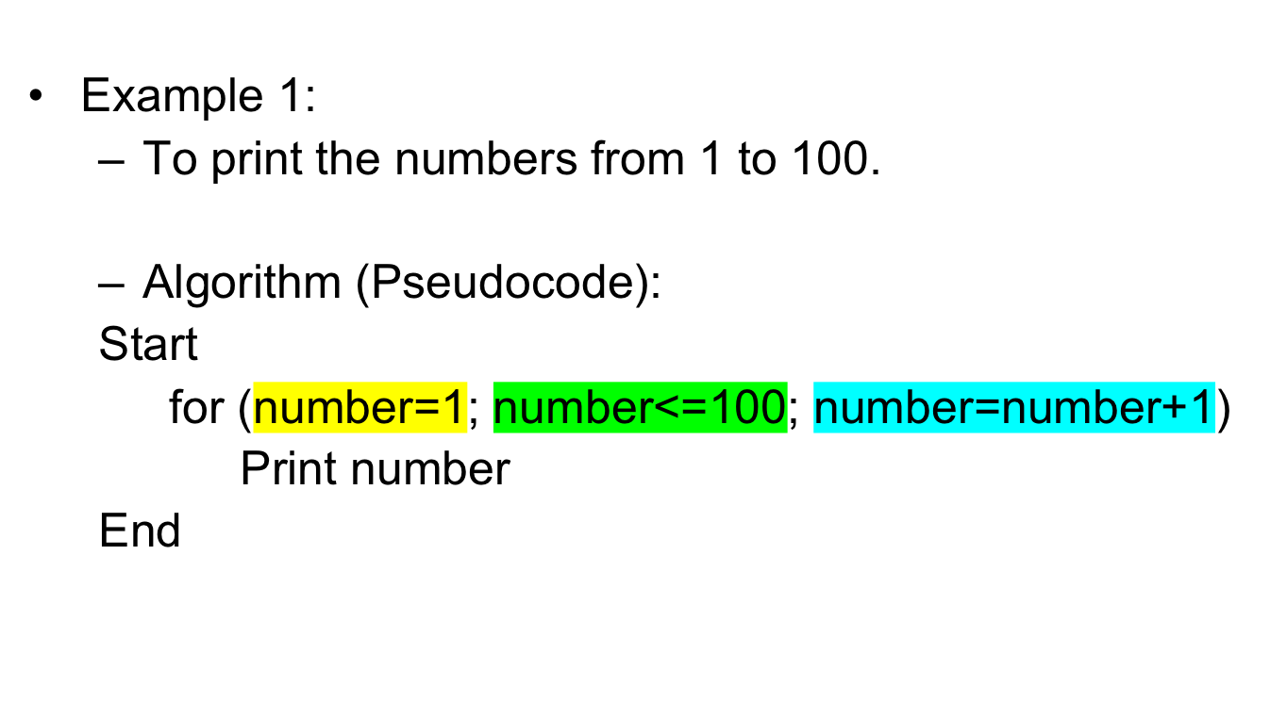
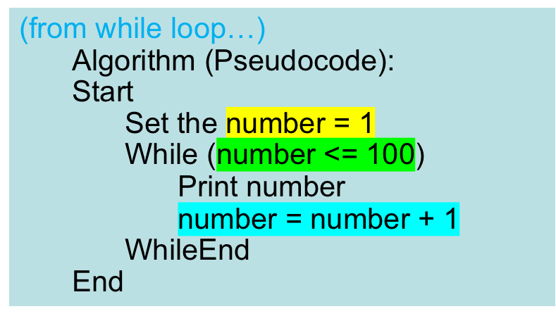
for Loops

Slide 83
for Loops
Example 2:
Get the sum of 1, 2, 3, …, 5.
Algorithm:
Set the total = 0
for (number = 1; number <= 5; number = number + 1)
total = total + number
Display total
Stmt # | number | total | Number <= 5 | Output
1 |  | 0

Slide 84
for Loops
Example 2:
Get the sum of 1, 2, 3, …, 5.
Algorithm:
Set the total = 0
for (number = 1; number <= 5; number = number + 1)
total = total + number
Display total
Stmt # | number | total | Number <= 5 | Output
1 |  | 0
2 | 1 |  | true

Slide 85
for Loops
Example 2:
Get the sum of 1, 2, 3, …, 5.
Algorithm:
Set the total = 0
for (number = 1; number <= 5; number = number + 1)
total = total + number
Display total
Stmt # | number | total | Number <= 5 | Output
1 |  | 0
2 | 1 |  | true
3 |  | 1

Slide 86
for Loops
Example 2:
Get the sum of 1, 2, 3, …, 5.
Algorithm:
Set the total = 0
for (number = 1; number <= 5; number = number + 1)
total = total + number
Display total
Stmt # | number | total | Number <= 5 | Output
1 |  | 0
2 | 1 |  | true
3 |  | 1
2 | 2 |  | true

Slide 87
for Loops
Example 2:
Get the sum of 1, 2, 3, …, 5.
Algorithm:
Set the total = 0
for (number = 1; number <= 5; number = number + 1)
total = total + number
Display total
Stmt # | number | total | Number <= 5 | Output
1 |  | 0
2 | 1 |  | true
3 |  | 1
2 | 2 |  | true
3 |  | 3

Slide 88
for Loops
Example 2:
Get the sum of 1, 2, 3, …, 5.
Algorithm:
Set the total = 0
for (number = 1; number <= 5; number = number + 1)
total = total + number
Display total
Stmt # | number | total | Number <= 5 | Output
1 |  | 0
2 | 1 |  | true
3 |  | 1
2 | 2 |  | true
3 |  | 3
2 | 3 |  | true

Slide 89
for Loops
Example 2:
Get the sum of 1, 2, 3, …, 5.
Algorithm:
Set the total = 0
for (number = 1; number <= 5; number = number + 1)
total = total + number
Display total
Stmt # | number | total | Number <= 5 | Output
1 |  | 0
2 | 1 |  | true
3 |  | 1
2 | 2 |  | true
3 |  | 3
2 | 3 |  | true
3 |  | 6

Slide 90
for Loops
Example 2:
Get the sum of 1, 2, 3, …, 5.
Algorithm:
Set the total = 0
for (number = 1; number <= 5; number = number + 1)
total = total + number
Display total
Stmt # | number | total | Number <= 5 | Output
1 |  | 0
2 | 1 |  | true
3 |  | 1
2 | 2 |  | true
3 |  | 3
2 | 3 |  | true
3 |  | 6
2 | 4 |  | true

Slide 91
for Loops
Example 2:
Get the sum of 1, 2, 3, …, 5.
Algorithm:
Set the total = 0
for (number = 1; number <= 5; number = number + 1)
total = total + number
Display total
Stmt # | number | total | Number <= 5 | Output
1 |  | 0
2 | 1 |  | true
3 |  | 1
2 | 2 |  | true
3 |  | 3
2 | 3 |  | true
3 |  | 6
2 | 4 |  | true
3 |  | 10

Slide 92
for Loops
Example 2:
Get the sum of 1, 2, 3, …, 5.
Algorithm:
Set the total = 0
for (number = 1; number <= 5; number = number + 1)
total = total + number
Display total
Stmt # | number | total | Number <= 5 | Output
1 |  | 0
2 | 1 |  | true
3 |  | 1
2 | 2 |  | true
3 |  | 3
2 | 3 |  | true
3 |  | 6
2 | 4 |  | true
3 |  | 10
2 | 5 |  | true

Slide 93
for Loops
Example 2:
Get the sum of 1, 2, 3, …, 5.
Algorithm:
Set the total = 0
for (number = 1; number <= 5; number = number + 1)
total = total + number
Display total
Stmt # | number | total | Number <= 5 | Output
1 |  | 0
2 | 1 |  | true
3 |  | 1
2 | 2 |  | true
3 |  | 3
2 | 3 |  | true
3 |  | 6
2 | 4 |  | true
3 |  | 10
2 | 5 |  | true
3 |  | 15

Slide 94
for Loops
Example 2:
Get the sum of 1, 2, 3, …, 5.
Algorithm:
Set the total = 0
for (number = 1; number <= 5; number = number + 1)
total = total + number
Display total
Stmt # | number | total | Number <= 5 | Output
1 |  | 0
2 | 1 |  | true
3 |  | 1
2 | 2 |  | true
3 |  | 3
2 | 3 |  | true
3 |  | 6
2 | 4 |  | true
3 |  | 10
2 | 5 |  | true
3 |  | 15
2 | 6 |  | false

Slide 95
for Loops
Example 2:
Get the sum of 1, 2, 3, …, 5.
Algorithm:
Set the total = 0
for (number = 1; number <= 5; number = number + 1)
total = total + number
Display total
Stmt # | number | total | Number <= 5 | Output
1 |  | 0
2 | 1
3 |  | 1
2 | 2
3 |  | 3
2 | 3
3 |  | 6
2 | 4
3 |  | 10
2 | 5
3 |  | 15
2 | 6
4 |  |  |  | 15

Slide 96
Trace for Loop
animation
Initialize count
for (int count = 0; count < 2; count++)
System.out.println("Welcome to Java!");
count
0

Slide 97
Trace for Loop
animation
(count < 2) is true
for (int count = 0; count < 2; count++)
System.out.println("Welcome to Java!");
count
0

Slide 98
Trace for Loop
animation
Print Welcome to Java!
for (int count = 0; count < 2; count++)
System.out.println("Welcome to Java!");
count
0
Output/Console:
Welcome to Java!

Slide 99
Trace for Loop
animation
Increase count by 1
count is 1 now
for (int count = 0; count < 2; count++)
System.out.println("Welcome to Java!");
count
1
Output/Console:
Welcome to Java!

Slide 100
Trace for Loop
animation
(count < 2) is still true since count is 1
for (int count = 0; count < 2; count++)
System.out.println("Welcome to Java!");
count
1
Output/Console:
Welcome to Java!

Slide 101
Trace for Loop
animation
Print Welcome to Java!
for (int count = 0; count < 2; count++)
System.out.println("Welcome to Java!");
count
1
Output/Console:
Welcome to Java!
Welcome to Java!

Slide 102
Trace for Loop
animation
Increase count by 1
count is 2 now
for (int count = 0; count < 2; count++)
System.out.println("Welcome to Java!");
count
2
Output/Console:
Welcome to Java!
Welcome to Java!

Slide 103
Trace for Loop
animation
(count < 2) is false since count is 2 now
for (int count = 0; count < 2; count++)
System.out.println("Welcome to Java!");
count
2
Output/Console:
Welcome to Java!
Welcome to Java!

Slide 104
Trace for Loop
animation
for (int count = 0; count < 2; count++)
System.out.println("Welcome to Java!");
count
2
The loop exits. Execute the next statement after the loop.
Output/Console:
Welcome to Java!
Welcome to Java!

Slide 105
Examples
for (int b = 10; b > 6; b--) {
System.out.print(b + “ “);
}
System.out.print(“End loop”);
Loop body is executed, until the condition becomes False
for (int b = 10; b < 6; b--) {
System.out.print(b + “ “);
}
System.out.print(“End loop”);
Loop body is never executed, because the condition is always False

Slide 106
Example 3: Average Mark
Pseudocode:
Start
Set totalMark= 0.0
for (count = 0; count < 5; count = count + 1)
Read mark totalMark = totalMark + mark
averageMark = totalMark/5
Print averageMark
End
Flowchart?

Slide 107
Note
The initial-action in a for loop can be a list of zero or more comma-separated expressions.
The action-after-each-iteration in a for loop can be a list of zero or more comma-separated statements.
Therefore, the following two for loops are correct.
They are rarely used in practice, however.
for (int i = 1; i < 100; System.out.println(i++));
for (int i = 0, j = 0; (i + j < 10); i++, j++) {
// Do something
}

Slide 108
Note
If the loop-continuation-condition in a for loop is omitted, it is implicitly true.
Thus the statement given below in (A), which is an infinite loop, is correct.
Nevertheless, it is recommended that you use the equivalent loop in (B) to avoid confusion:

Slide 109
Using for Loop
Problem:
Write a program that sums a series that starts with 0.01 and ends with 1.0. The numbers in the series will increment by 0.01, as follows: 0.01 + 0.02 + 0.03 and so on.

Slide 110
public class ForLoopExample {
public static void main(String[] args) {
double i;
double sum = 0.0;
for {i = 0.01; i <= 1.0; i = i + 0.01)
{
sum = sum + i;
}
System.out.println (“The sum is “ + sum);
}

Slide 111
Exercises
Write a for loop that prints the numbers from 1 to 100.
Write a for loop to get the sum of 1 to 100 integer numbers ( 1+2+3+..+100)

Slide 112
Examples using for Loops
Draw a flowchart that reads 100 random integer numbers.
Write a pseudocode that finds the smallest of 100 integer numbers.
Write a program that reads and calculates the sum of an unspecified number of integers. The input 0 signifies the end of the input.

Slide 113
Exercises
Write a while loop that prints odd numbers from 1 to 10.
Rewrite the above code using a do-while loop.
Rewrite the above code using a for loop.

Slide 114
Nested loop

Slide 115
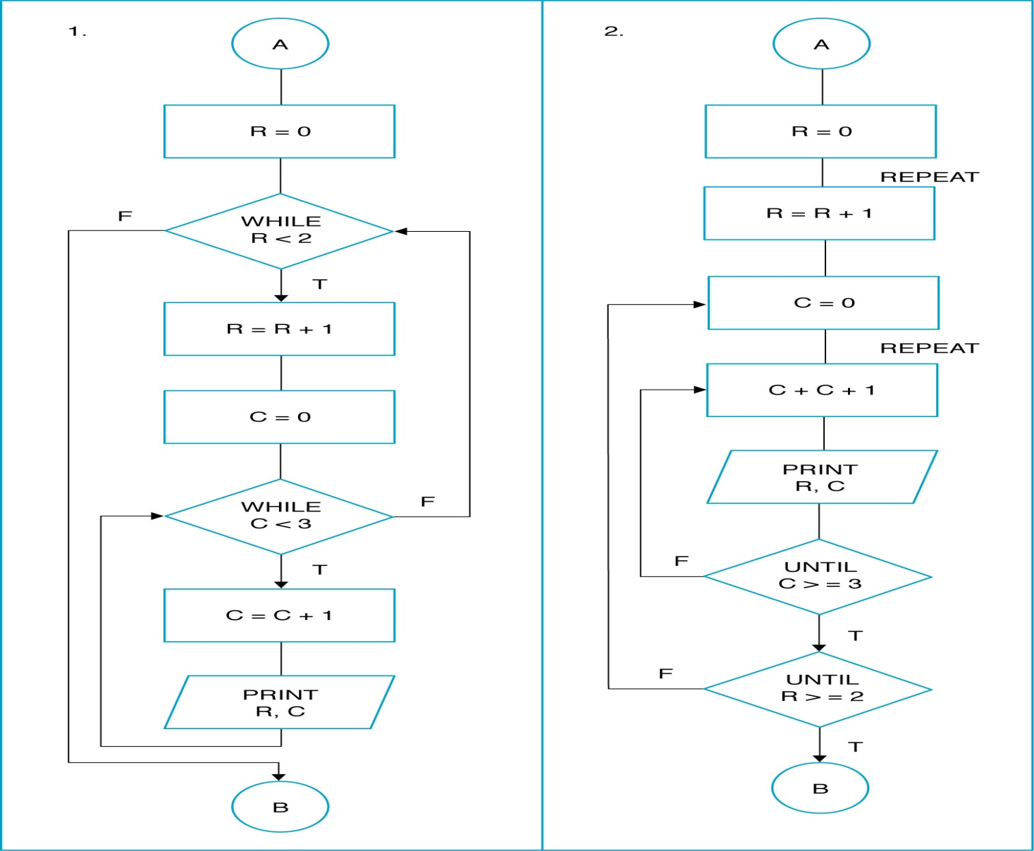
NESTED LOOP

Slide 116
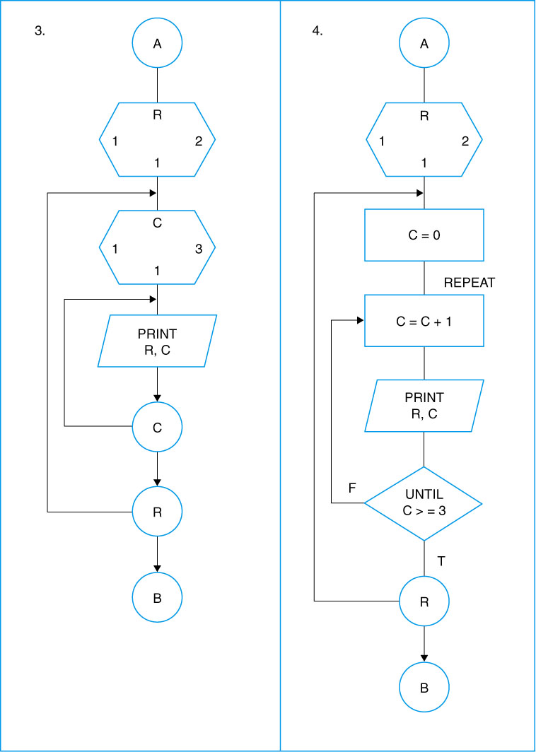
NESTED LOOP

Slide 117
Example
for (int x = 1; x <= 5; x++){
int y = 10;
while (y >= 0) {
System.out.println (x + “\t” + y);
y -= 2;
}
System.out.println (“-----”);
}
System.out.println (“*****”);
Output?

Slide 118
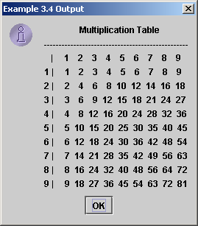
Displaying the Multiplication Table
Problem: Write a program that uses nested for loops to print a multiplication table.

Slide 119
for (int i = 1; i <= 9; i++) {
System.out.print(“\n” + i);
for (int j = 1; j <= 9; j++) {
System.out.print (“\t” + (i*j));
}
}

Slide 120
Example using nested-loop
Write a loop structure to read the number of students in a class, and for each student, read the marks for three subjects, and print the total marks.

Slide 121
Example using nested-loop:
while in for
Scanner input = new Scanner(System.in);
System.out.print(“Enter the number of students: “);
int numOfStd = input.nextInt();
double mark = 0.0;
double total = 0.0;
for(int i = 1; i <= numOfStd; i++) {
System.out.println(“For student “ + i);
int subject = 1;
while (subject <= 3) {
System.out.print(“Enter mark for subject “ + subject + ": ");
mark = input.nextDouble(); // Read mark
total += mark;
subject++;
}
System.out.println(“Total marks for student “ + i + “ = ” + total);
}

Slide 122
Example using nested-loop:
for in for
Scanner input = new Scanner(System.in);
System.out.print(“Enter the number of students: “);
int numOfStd = input.nextInt();
double mark = 0.0;
double total = 0.0;
for (int i = 1; i <= numOfStd; i++) {
System.out.println(“For student “ + i);
for (int subject = 1; subject <= 3; subject++) {
System.out.print(“Enter mark for subject “ + subject + ": ");
mark = input.nextDouble(); // Read mark
total += mark;
}
System.out.println(“Total marks for student “ + i + “ = ” + total);
}

Slide 123
Break / Continue in Loops
public class TestBreak {
public static void main(String[] args) {
int sum = 0;
int number = 0;
while (number < 20) {
number++;
sum += number;
if (sum >= 100)
break;
}
System.out.println(“The number is “ + number);
System.out.println(“The sum is “ + sum);
}
}

Slide 124
Break / Continue in Loops
public class TestContinue {
public static void main(String[] args) {
int sum = 0;
int number = 0;
while (number < 20) {
number++;
if (number == 10 || number == 11)
continue;
sum += number;
}
System.out.println("The sum is " + sum);
}
}

Slide 125
Which Loop to Use?
The three forms of loop statements, while, do-while, and for, are expressively equivalent; that is, you can write a loop in any of these three forms. For example, a while loop in (A) in the following figure can always be converted into the following for loop in (B):
A for loop in (A) in the following figure can generally be converted into the following while loop in (B) except in certain special cases (see Review Question 3.19 for one of them):

Slide 126
Recommendations
It is recommended that you use the one that is most intuitive and comfortable for you.
In general, a for loop may be used if the number of repetitions is known, as, for example, when you need to print a message 100 times.
A while loop may be used if the number of repetitions is not known, as in the case of reading the numbers until the input is 0.
A do-while loop can be used to replace a while loop if the loop body has to be executed before testing the continuation condition.

Slide 127
Caution
Adding a semicolon at the end of the for clause before the loop body is a common mistake, as shown below:
for (int i=0; i<10; i++);
{
System.out.println("i is " + i);
}
Logic Error

Slide 128
Caution, cont.
Similarly, the following loop is also wrong:
int i=0;
while (i < 10);
{
System.out.println("i is " + i);
i++;
}
However, in the case of the do-while loop, the following semicolon is needed to end the loop.
int i=0;
do {
System.out.println("i is " + i);
i++;
} while (i<10);
Logic Error
Correct

Slide 129
Exercise
Write a program that finds the biggest of several integers. Assume that the first value read specifies the number of values to input from the user.

Slide 130
Exercise
Write a program that prompts the user to enter the number of students and each student’s name and score, and finally displays the student with the highest score.

Slide 131
Exercise
Write a program that displays all the numbers from 100 to 1000, ten per line, that are divisible by 5 and 6.

Slide 132
Exercise
Write a program to print the following pattern.
1
1 2
1 2 3
1 2 3 4
1 2 3 4 5
1 2 3 4 5 6

Slide 133
Problem Solving
You are asked to create a program that can display whether a student passed or failed in a subject based on a student’s 4 test scores. The program will calculate the average score of the test. If the average score is below 50, the student fails and vice versa.
Create IPO chart
Draw a flow chart
Write pseudocode -
Write a program code

